Slide 1
Find a Food Chain
Alabama Wildlife Federation Outdoor Classroom Field Journal Activity
To use this interactive PowerPoint with your students:
Click on “Enable Editing.”
Click the “Slide Show” tab at the top of the screen.
Then choose “From Beginning” from the menu.

Slide 2
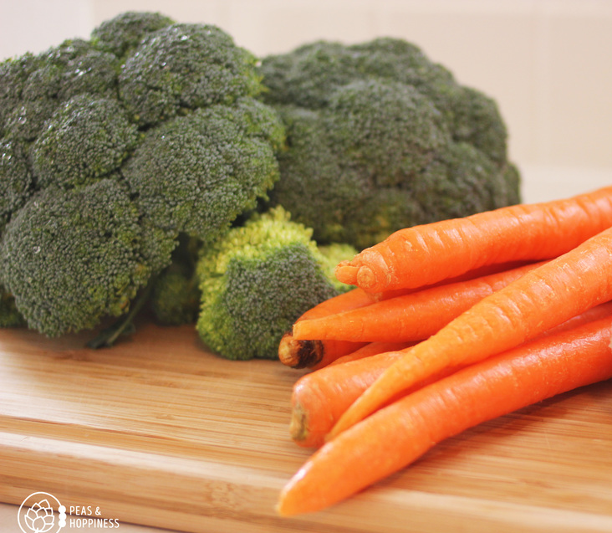
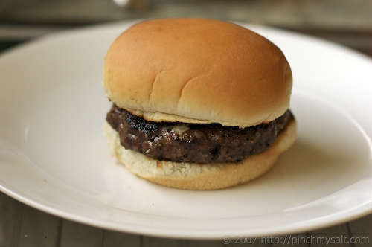
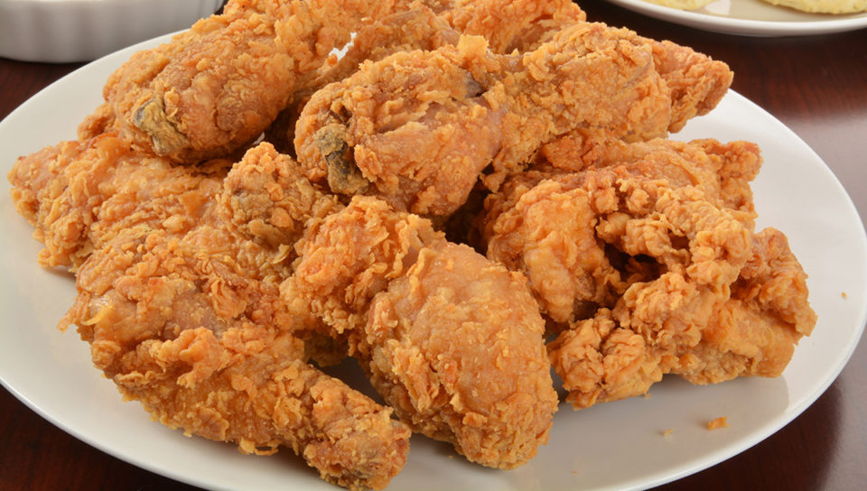
Do you eat plants? Raise your hands if you eat…
Do you eat animals? Raise your hands if you eat…
Fruit like apples or bananas
Vegetables like broccoli or carrots
Hamburgers
Fried chicken
Fruits and vegetables are parts of plants.
Hamburgers and fried chicken come from animals.

Slide 3
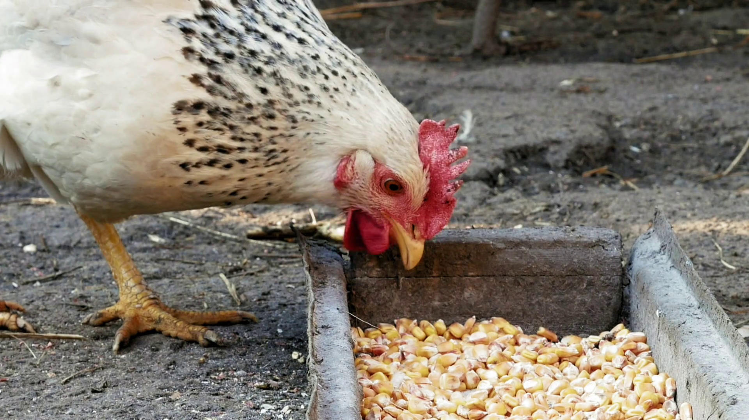
What do you think the chicken ate before you ate it?
Why do you and the chicken need to eat?
The chicken could have eaten corn, seeds, or bugs.
Because our bodies need the nutrients from the food we eat to give us energy to move, grow, stay warm and survive.

Slide 4
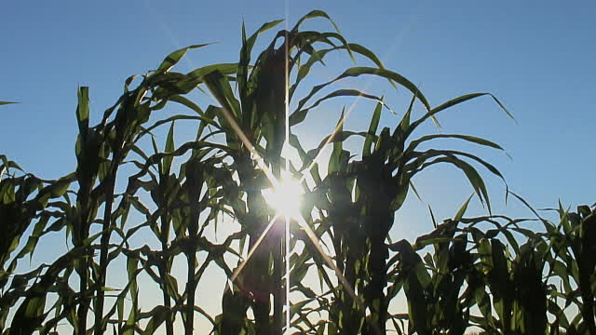
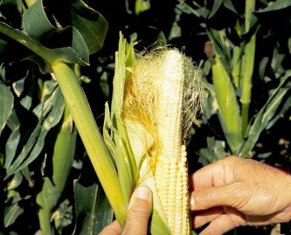
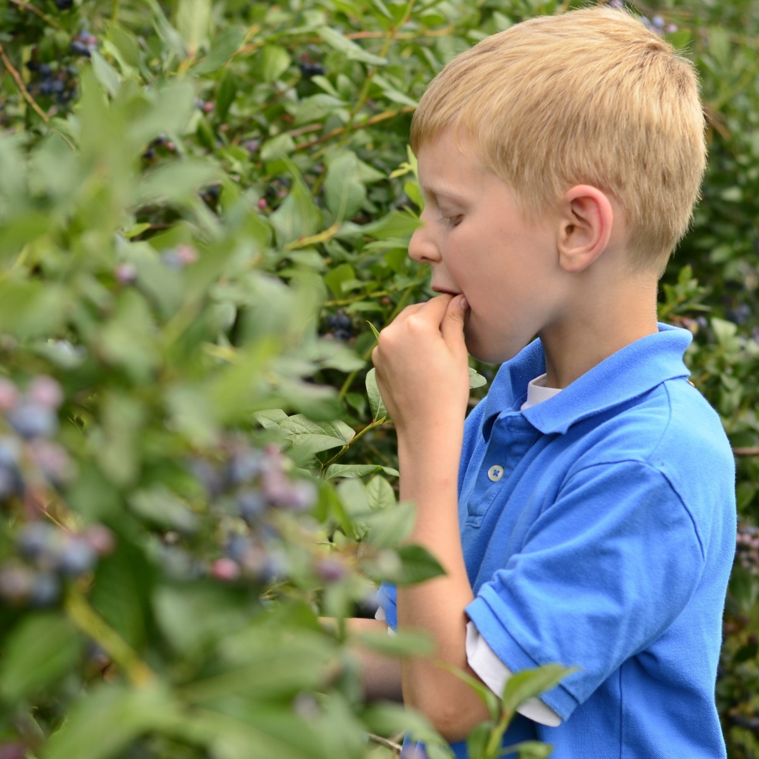
How does corn provide energy for the chicken?
How do fruits and vegetables provide us energy?
The “energy source” in the corn (and in all plants) originally comes from the sun.
The sun provides energy for the plants, and this energy is passed on to animals (like us) when we eat the plants.
This forms a food chain, and YOU are part of that food chain.

Slide 5
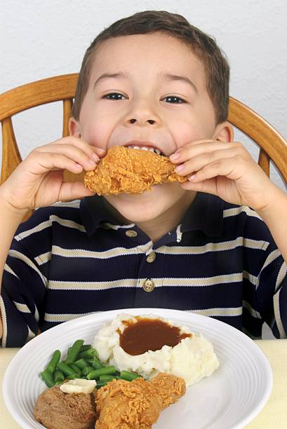
What is a Food Chain?
A food chain demonstrates the transfer of nutrients and energy (in the form of food) from one organism to another organism.
Each organism in the chain is linked together.
The sun provides energy for the corn.
The corn provides energy for the chicken.
The chicken provides energy for humans.

Slide 6
What is the original source of energy in all food chains for all living organisms?
The Sun!
You can feel the sun’s energy as heat when the sunlight touches your skin.
Plants receive the sun’s energy as the sunlight touches their leaves.

Slide 7
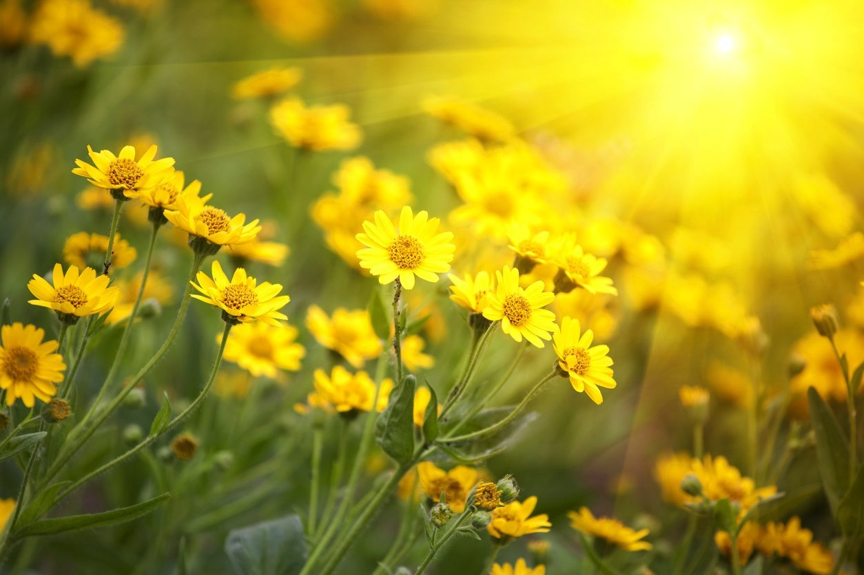
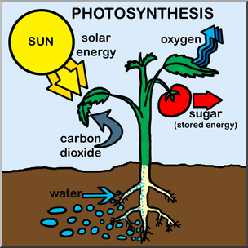
How do plants use the sunlight?
The plants use the energy from the sunlight to convert water from the soil and carbon dioxide from the air into sugars (or food).
This process is called
photosynthesis.
Because plants can produce their own food, they are called producers
of energy in a food chain.

Slide 8
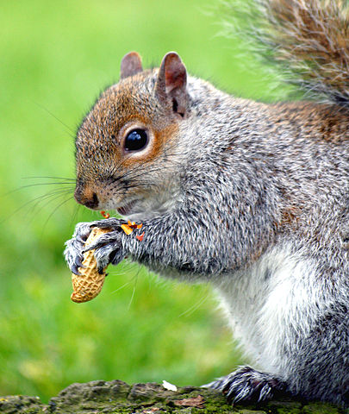
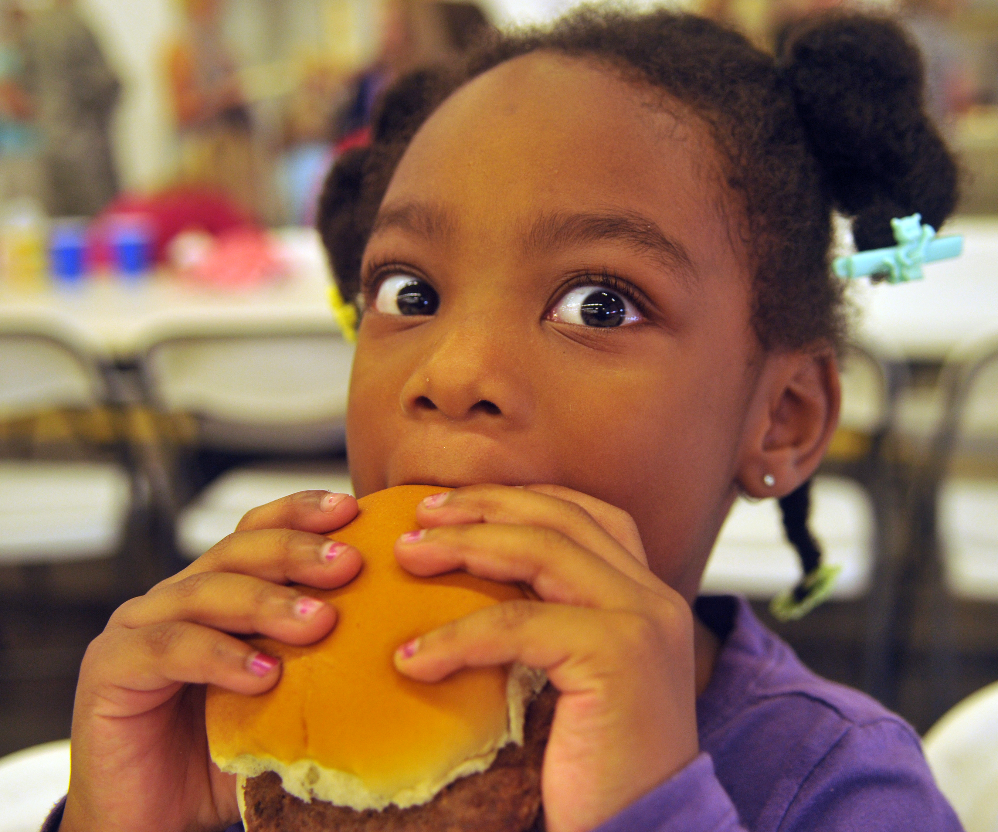
Can animals produce their own energy?
How do animals get their energy?
No, animals cannot produce their own energy like plants can.
We eat plants and animals for their energy.
Animals are the
consumers
of energy in a food chain.

Slide 9
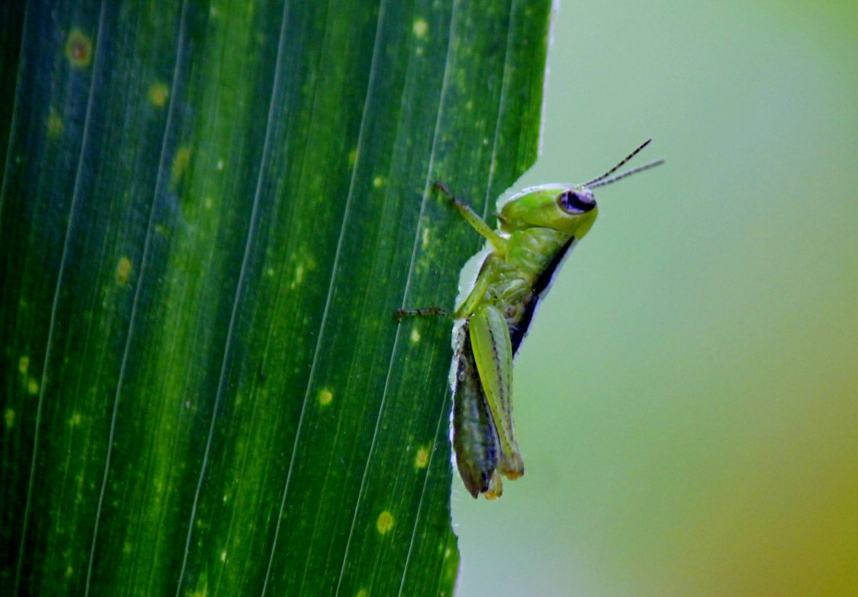
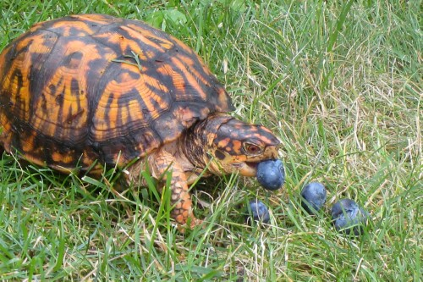
What do you call animals that eat only plants?
What are animals that eat plants and animals called?
Animals that eat only plants
are called
herbivores.
Animals that eat
plants and animals
are called
omnivores.
Grasshoppers are herbivores.
Box turtles are omnivores.
When animals eat plants, they are the primary consumers in a food chain.

Slide 10
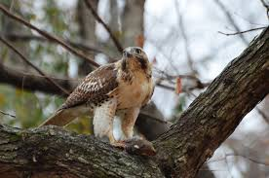
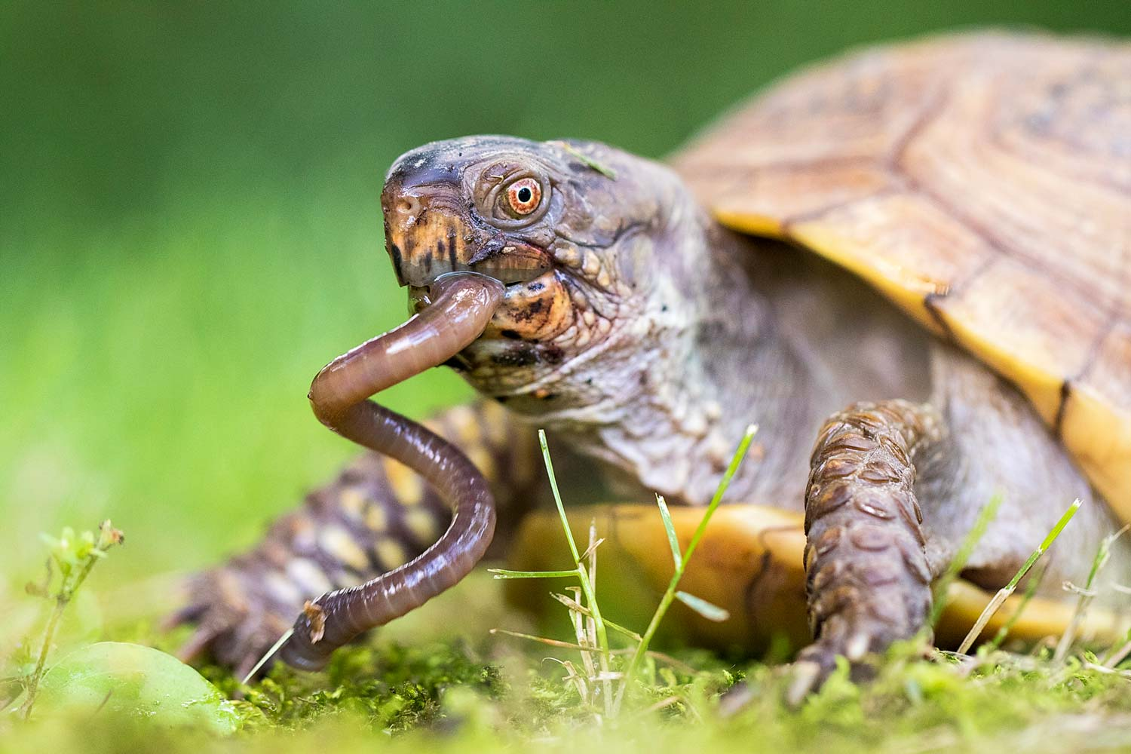
What are animals that eat only animals called?
Animals that eat
only animals
are called carnivores.
Animals that eat
plants and animals
are called
omnivores.
Hawks are carnivores.
When animal eat other animals they are the
secondary or tertiary consumers
in a food chain.

Slide 11
Let’s Review…
What are the different levels of a food chain?
The producers (plants) are eaten by
primary consumers (herbivores & omnivores),
which are eaten by
Apex Predator
secondary consumers (omnivores & carnivores),
which are eaten by
tertiary consumers (omnivores & carnivores).
The energy is passed on until you reach the apex predator.
The “apex predator” does not have any other animals that hunt it for food. It is the top predator.

Slide 12
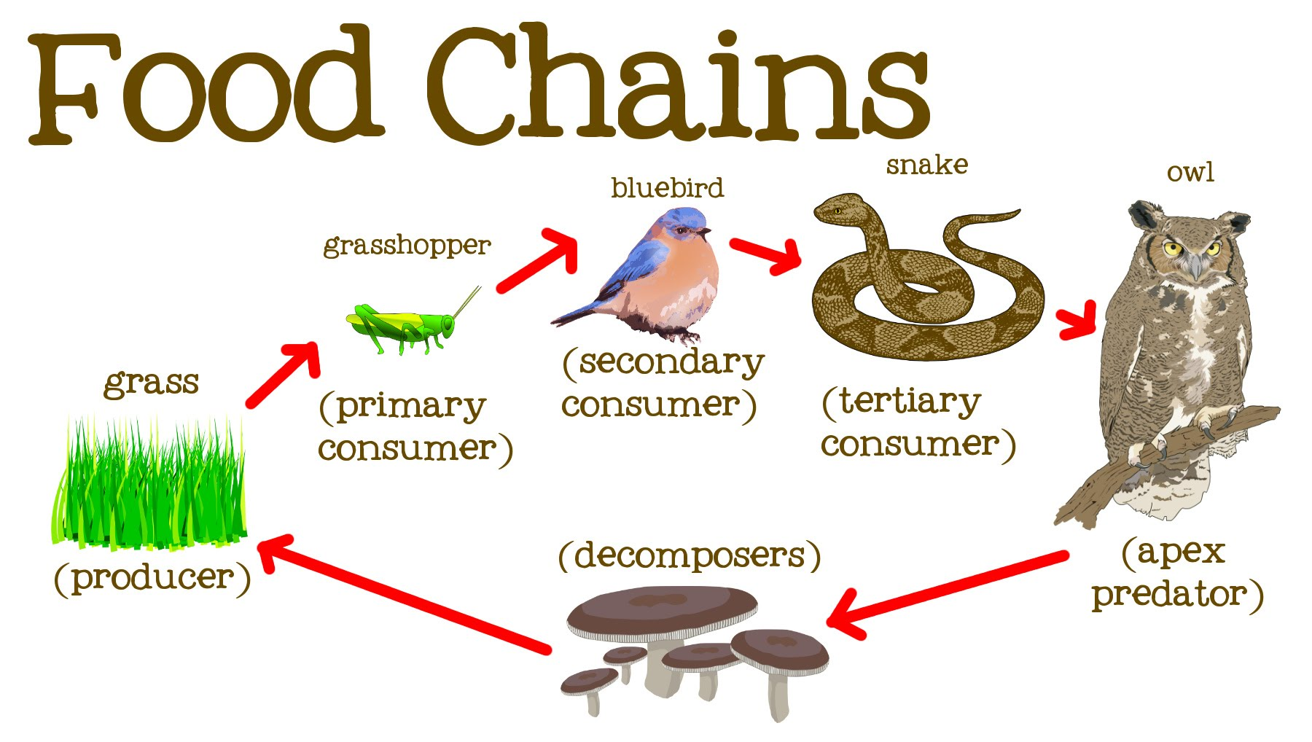
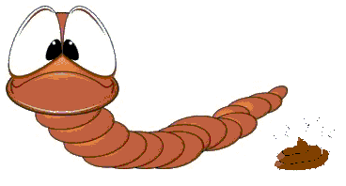
Does the Apex Predator complete the food chain?
No! The final link in the food chain is the decomposers.
When plants and animals die, then decomposers and scavengers eat the remains.
Then the decomposers’ excrement or “poop” returns the nutrients (energy) back to the soil.
For example, the “castings” (poop) of earthworms are considered rich fertilizer (food) for plants.
“Mine don’t stink!”

Slide 13
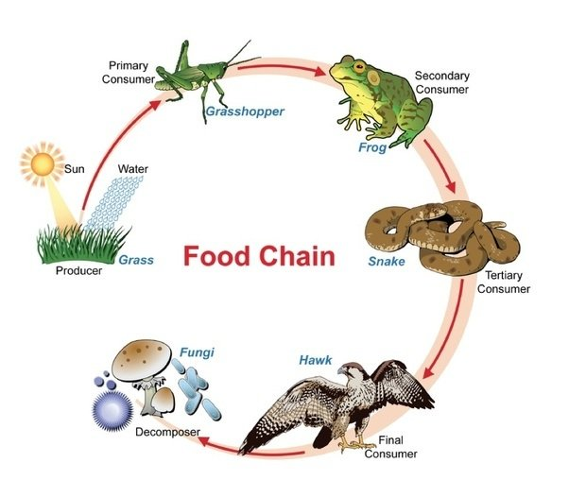
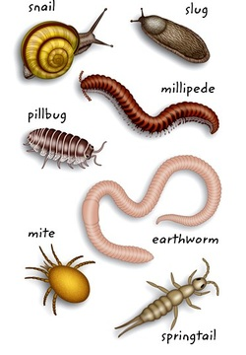
What are Decomposers? Why are they important?
They are the last stop on the food chain.
They eat the things no one else wants to.
They are very small so they can break down large pieces of dead stuff.
They are referred to as nature’s recyclers because they help return nutrients to the soil for the plants.
Some of the most common decomposers are worms, slugs, snails, fungi (mushrooms) and bacteria.
If they didn’t do their job the ground would be covered with dead stuff.

Slide 14
How does energy flow within a food chain?
Energy flows from the sun through the producers, through the consumers, through the decomposers, and then back through the producers to continue the cycle.
Sun
Producer (Plant)
Primary Consumer
(Animal: Herbivore)
Secondary Consumer
(Animal: Carnivore or Omnivore)
Tertiary Consumer
or Apex Predator (Animal)
Decomposer or Scavenger

Slide 15
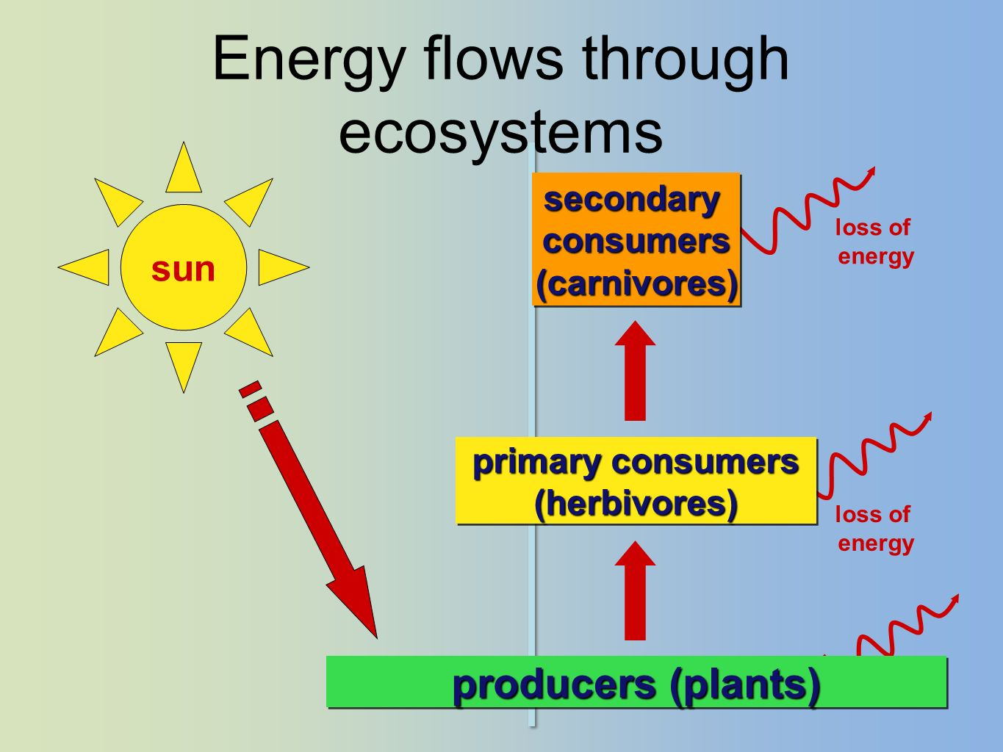
How much energy is passed on at each level?
Through all of these levels, only ~10% of the energy is passed on to the next level or consumer each time.
Sun
Producer (Plant)
Primary Consumer
(Animal: Herbivore or Omnivore)
Secondary Consumer
(Animal: Carnivore or Omnivore)
Tertiary Consumer
or Apex Predator (Animal)
Decomposer or Scavenger
10%
10%
10%
10%
10%

Slide 16
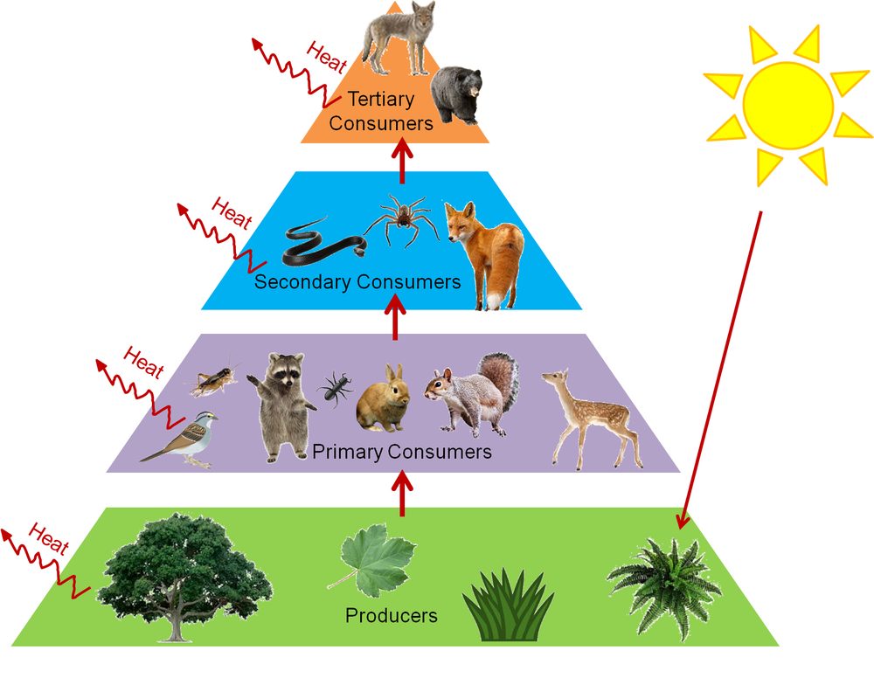
Where are we (humans) in Food Chains?
Can we be…Producers?
Consumers?
Apex Predator?
Yes, we are the apex predator because there are
no other animals in Alabama that would eat us.
Black bears are considered omnivores, but they do not hunt humans as prey.
Energy
Apex
Predator
Yes, we can be the primary consumers
if we eat plants (fruit & vegetables), or
we can be the secondary consumers
if we eat animals (chicken, cows, deer, etc.)
that eat plants.
Energy
Energy
No, we cannot be producers!
We cannot produce or make our own energy from the sun like plants can.
Energy

Slide 17
What food chains could we find in our outdoor classroom? What should you look for outside?
Producers like…
grass
trees
flowers.
Consumers like…
birds
squirrels
spiders.
Decomposers like…
pill bugs
worms
mushrooms.
*Be sure to use the Example Food Chain Components Chart with your activity sheets.

